Slide 1
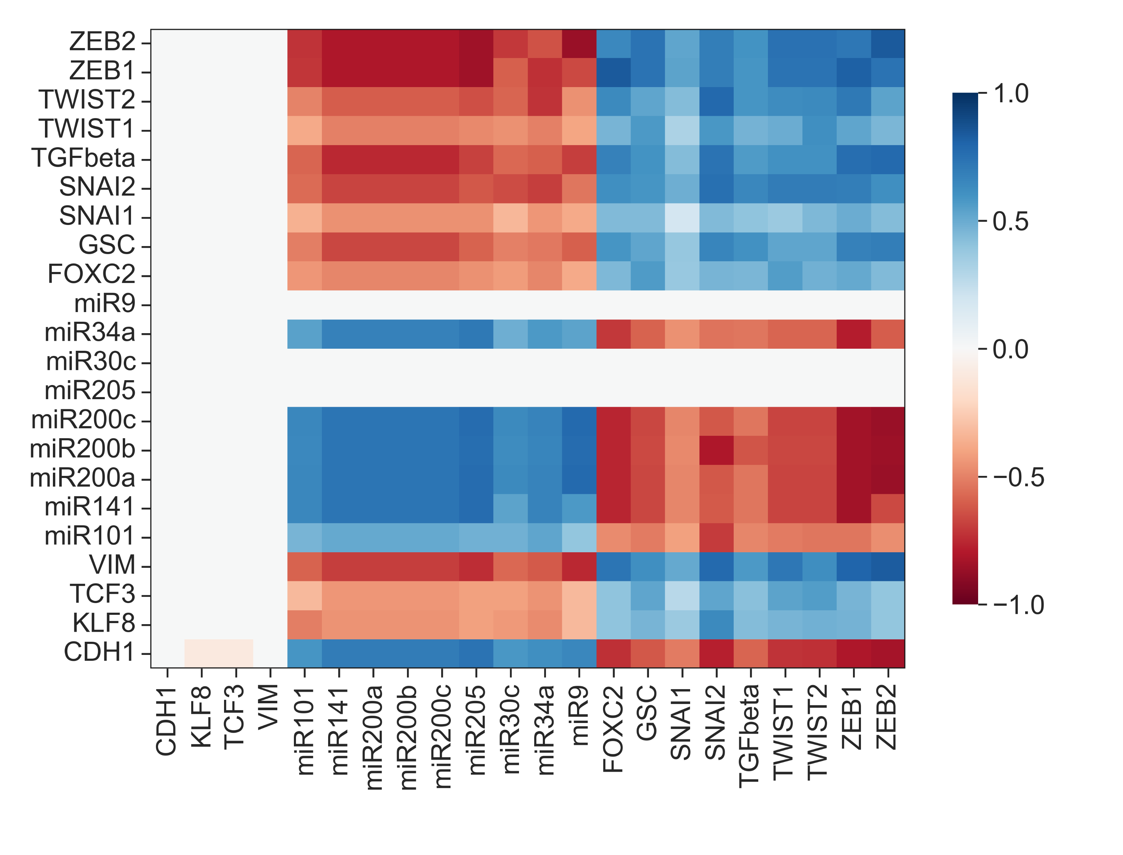
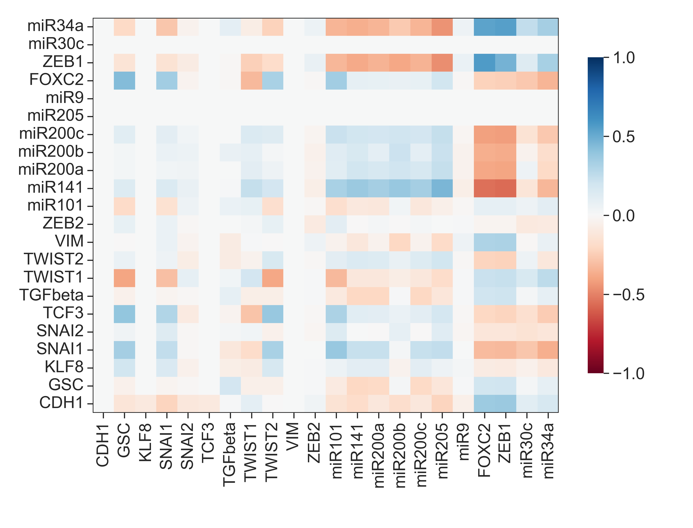
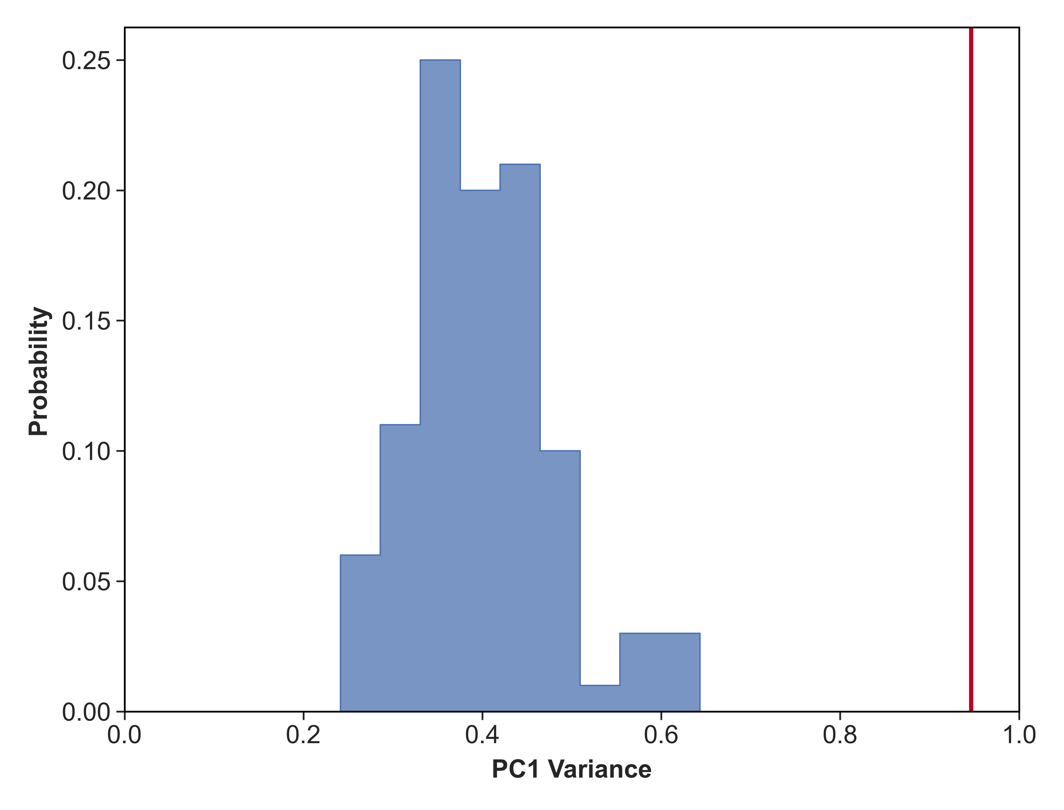
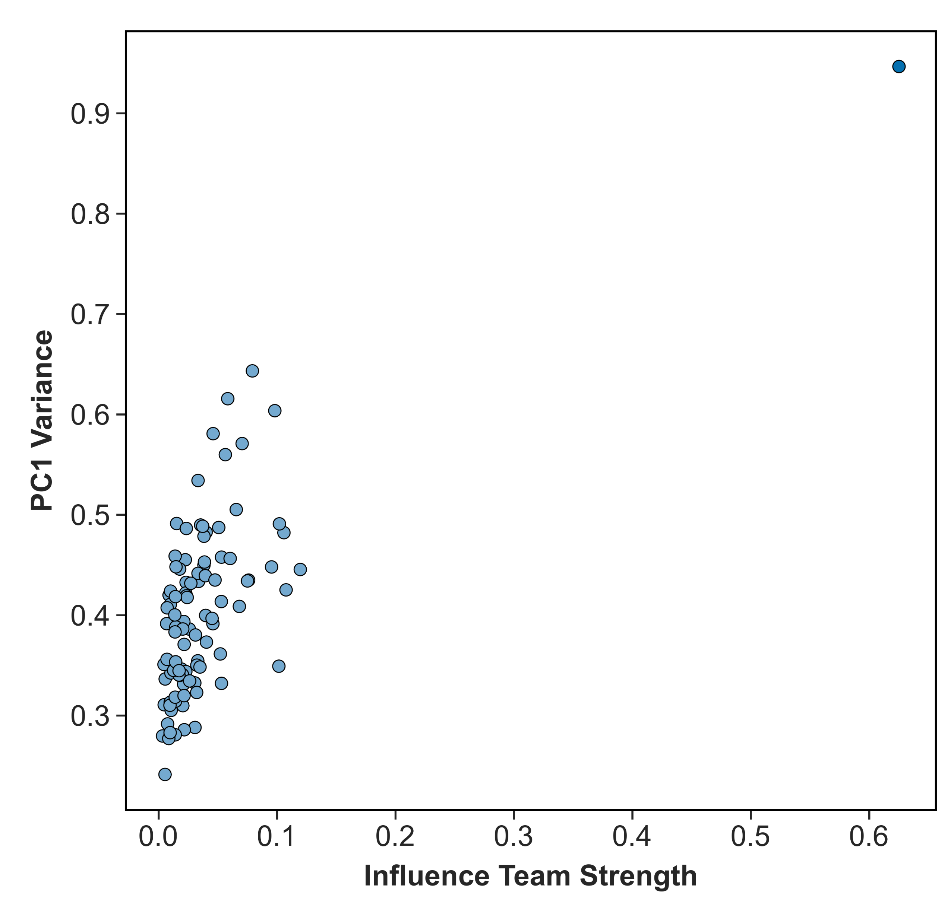
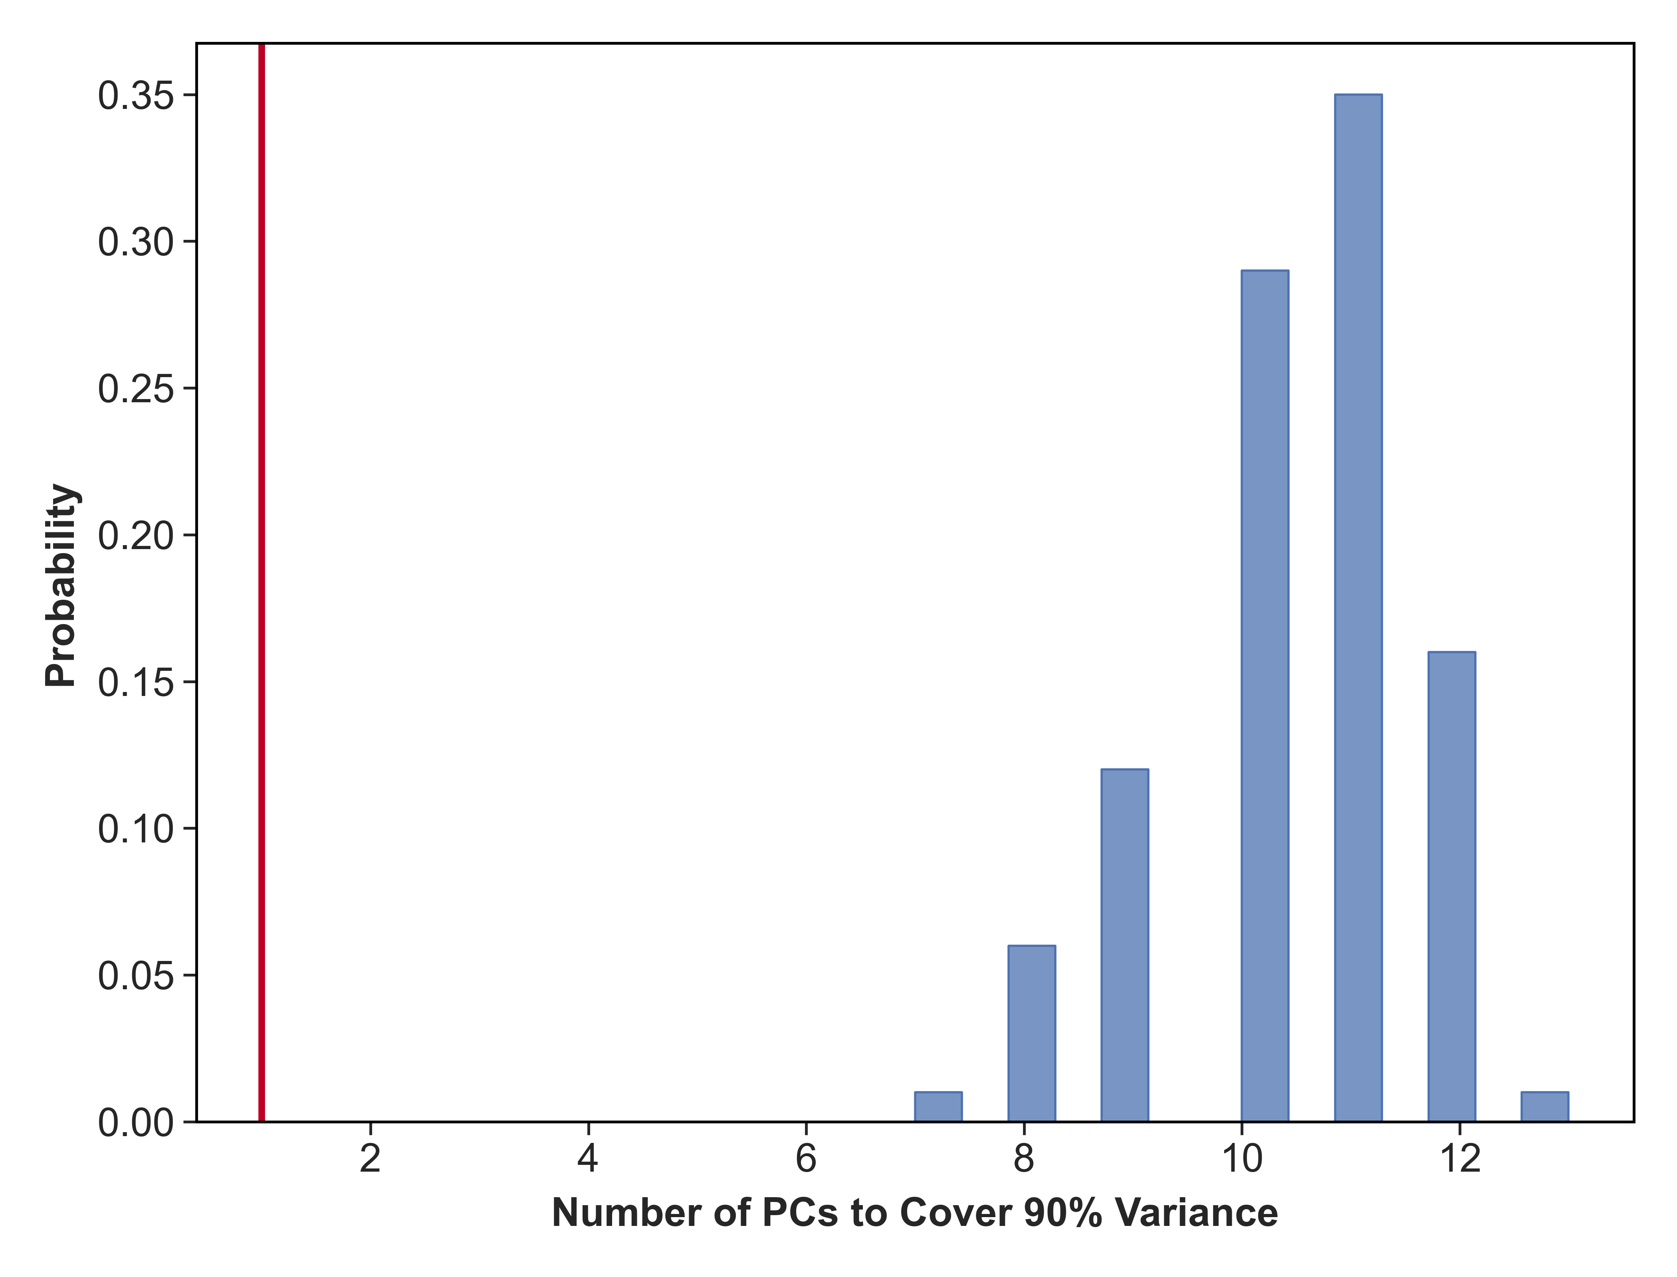
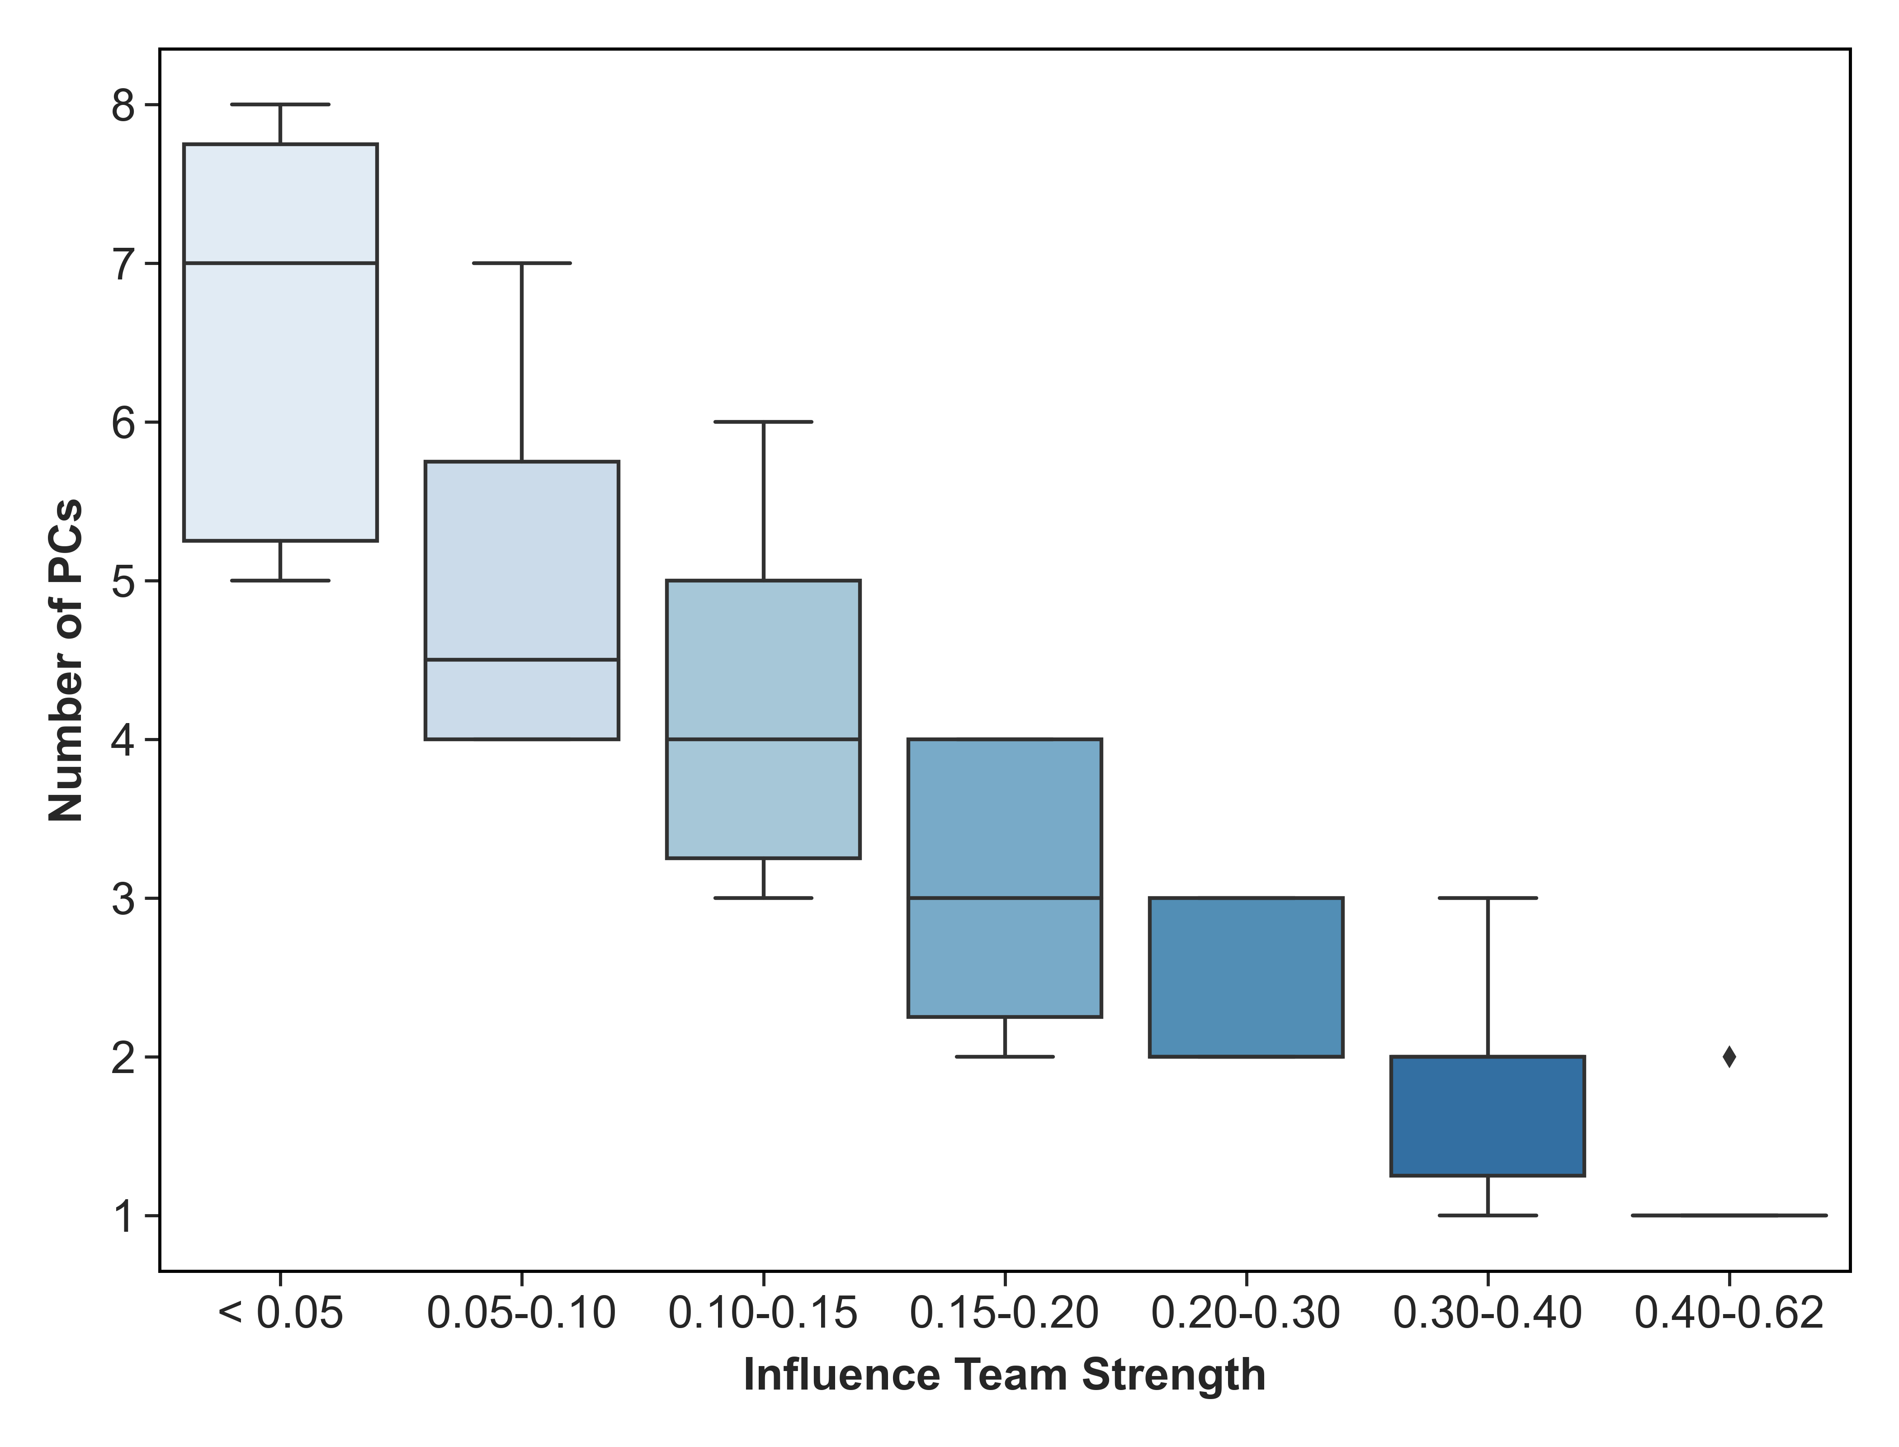

A (i)
A (ii)
B
C
D
E
Influence matrix for (i) WT vs (ii) random network.
Histogram depicting the variance explained by PC1 EMP network (red vertical line) and random networks.
Dependence of variance explained by PC1 on the team strength calculated from the influence matrix
Barplot/Histogram depicting the number of principle components required to explain 90% of the variance in EMP network (red vertical line) and random networks
Boxplot depicting the dependence on the number of PCs required to explain 90% variance on the team strength of a network.

Slide 2
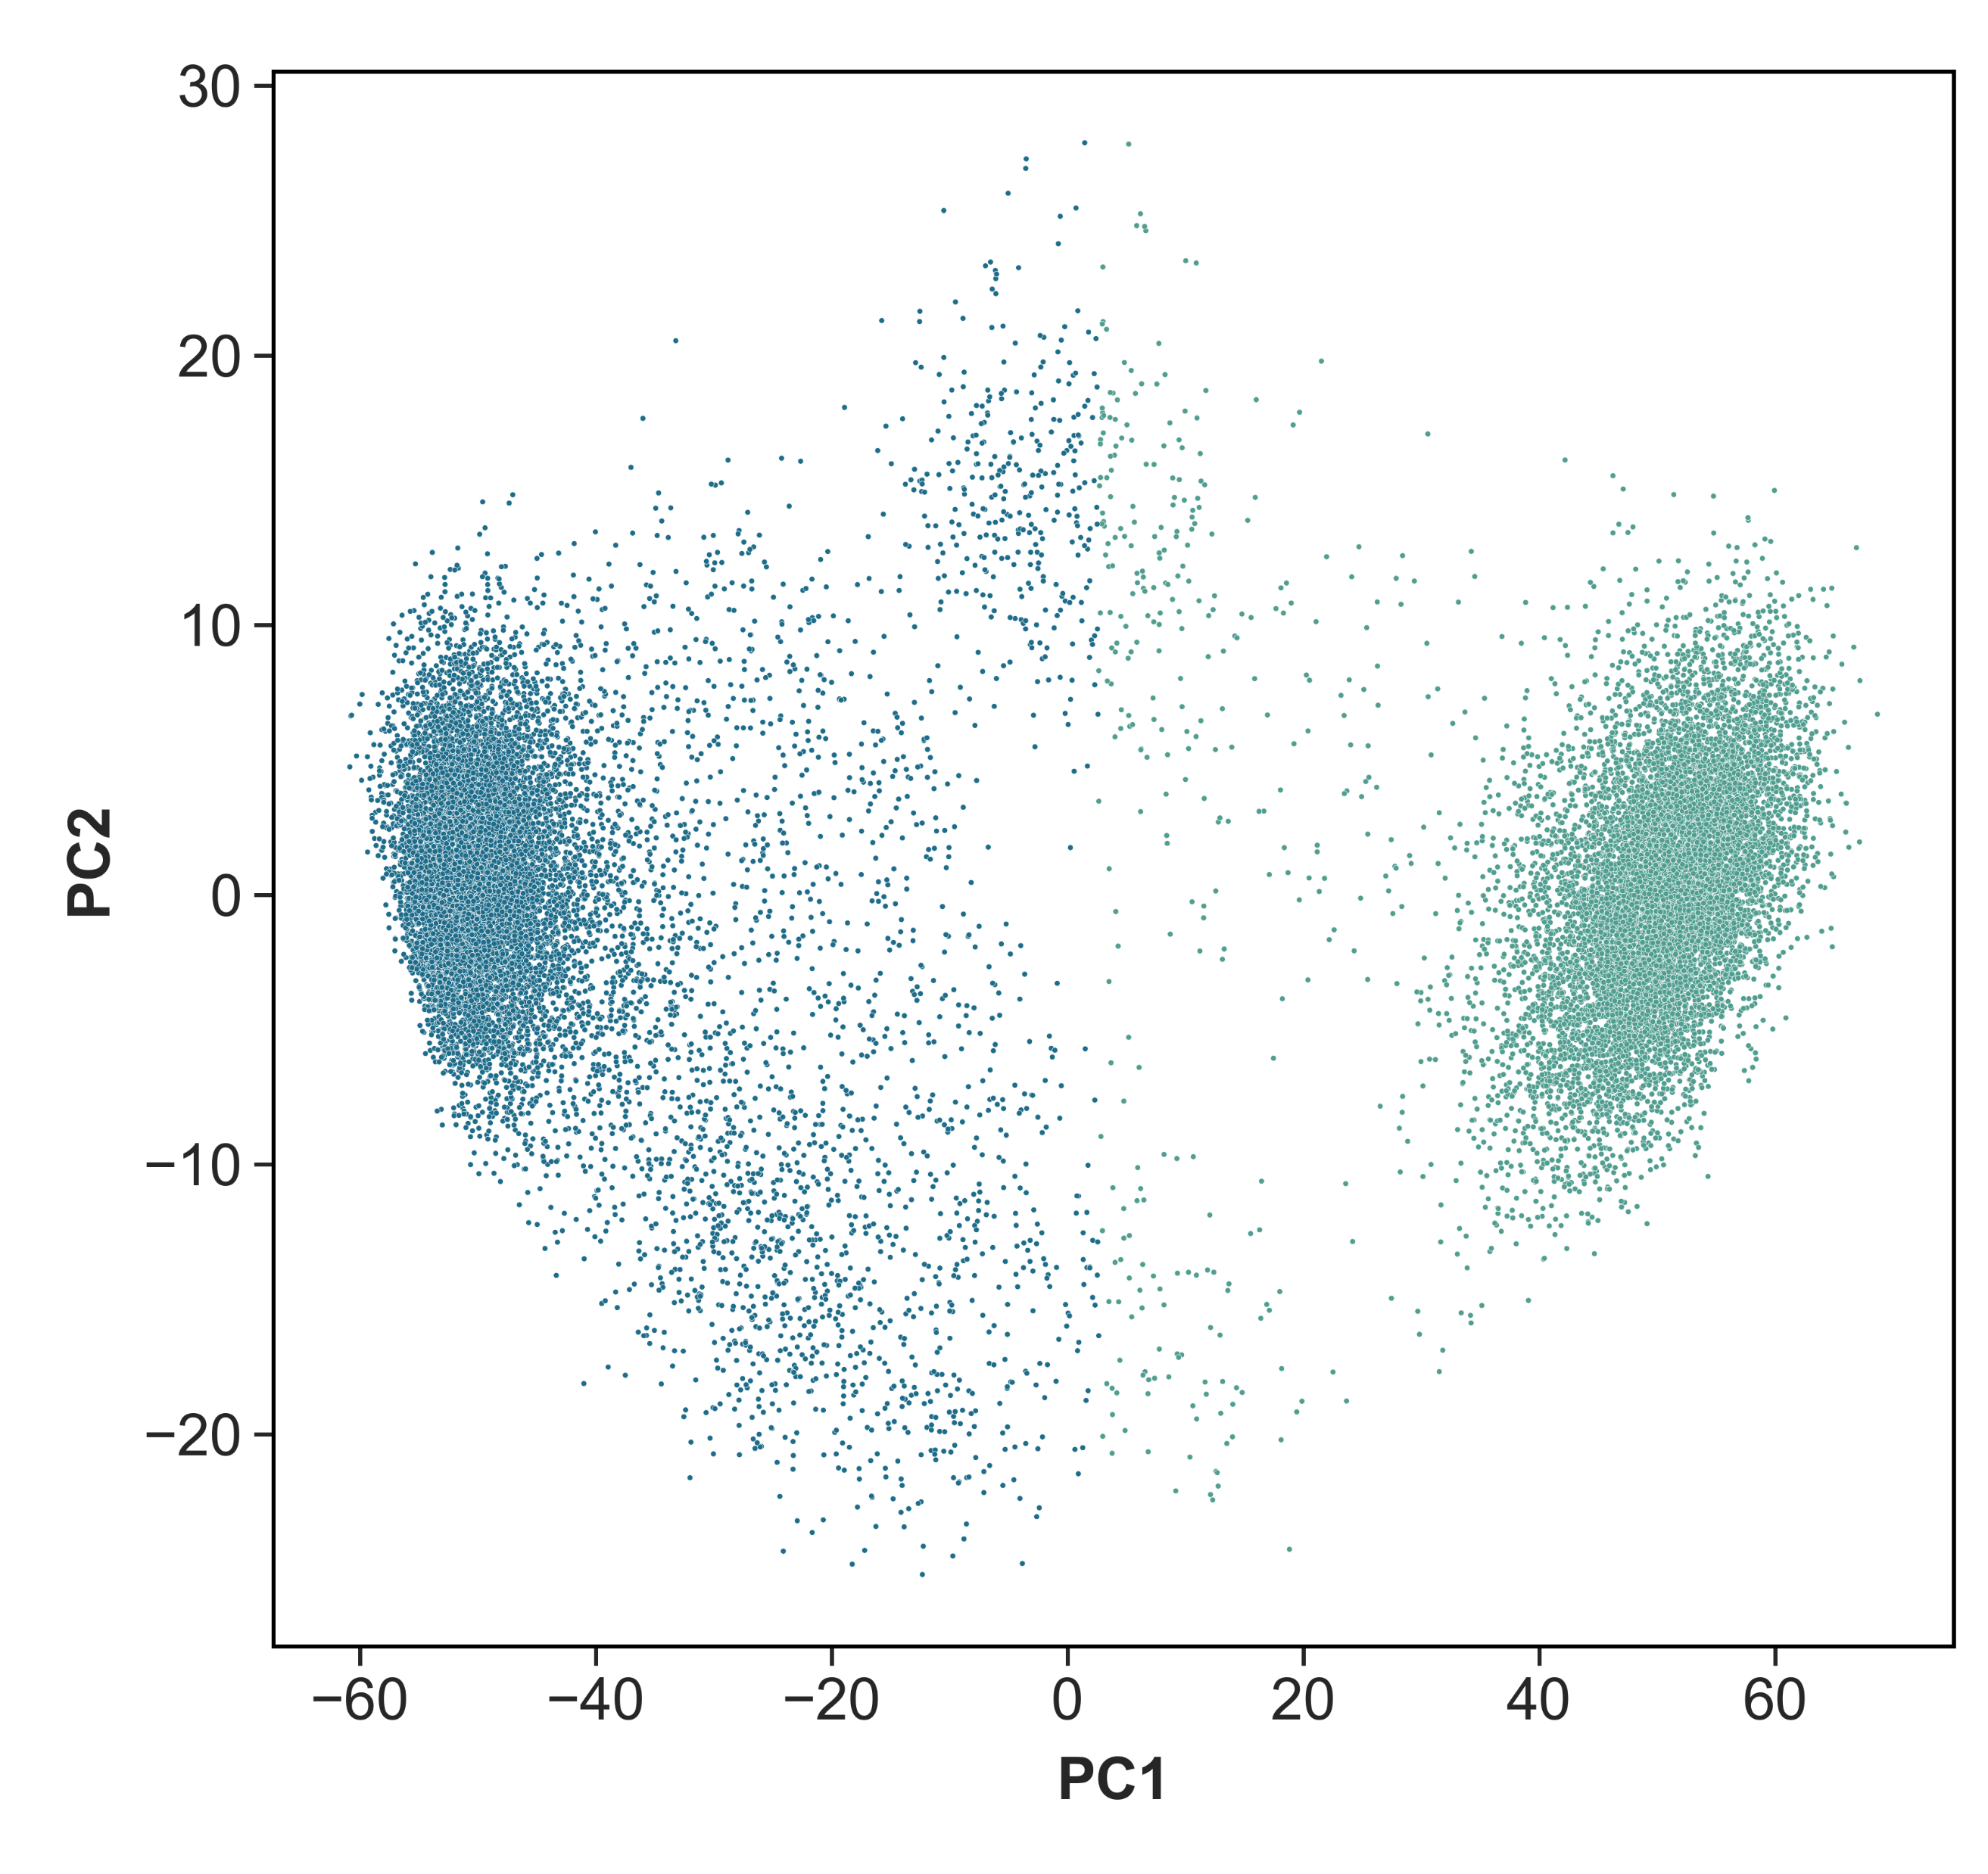
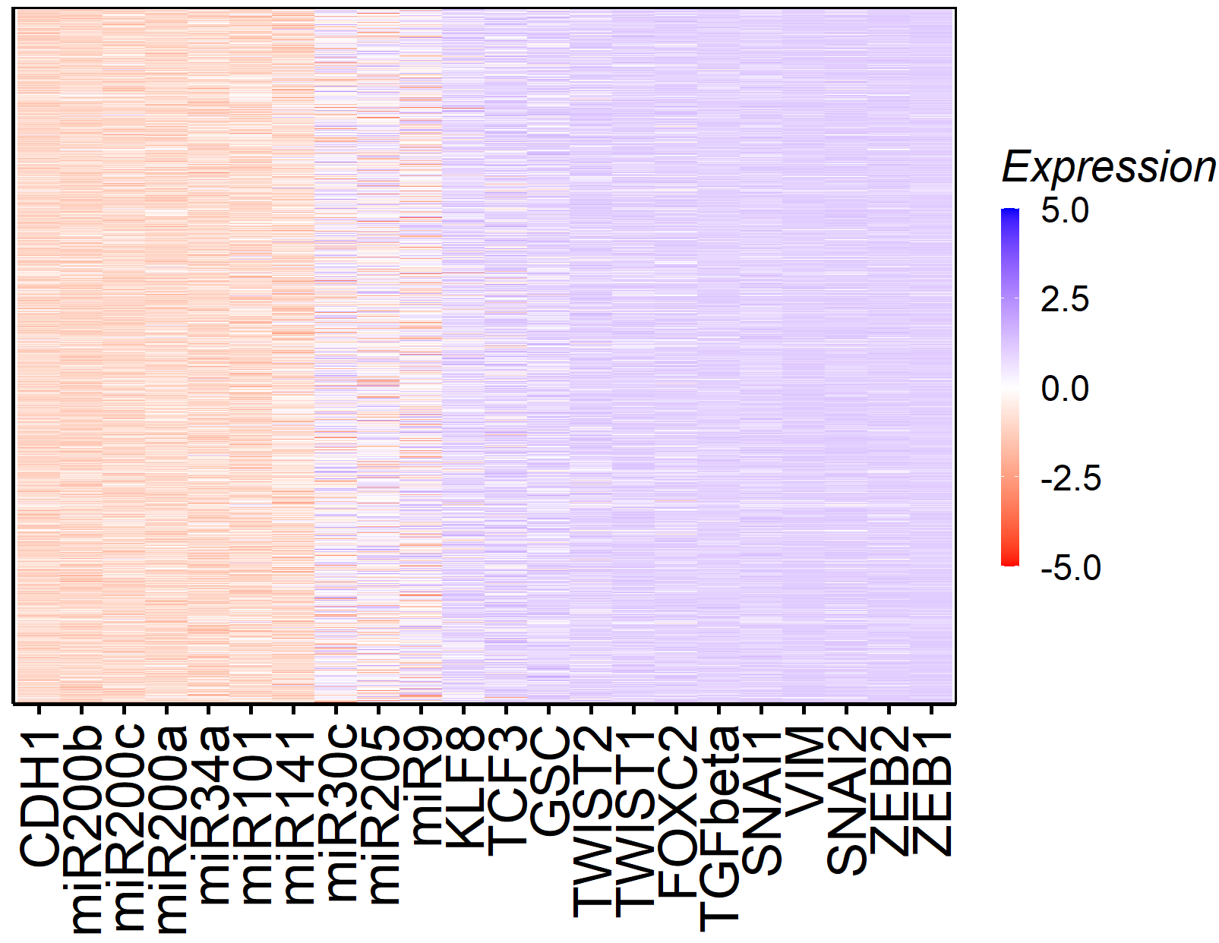
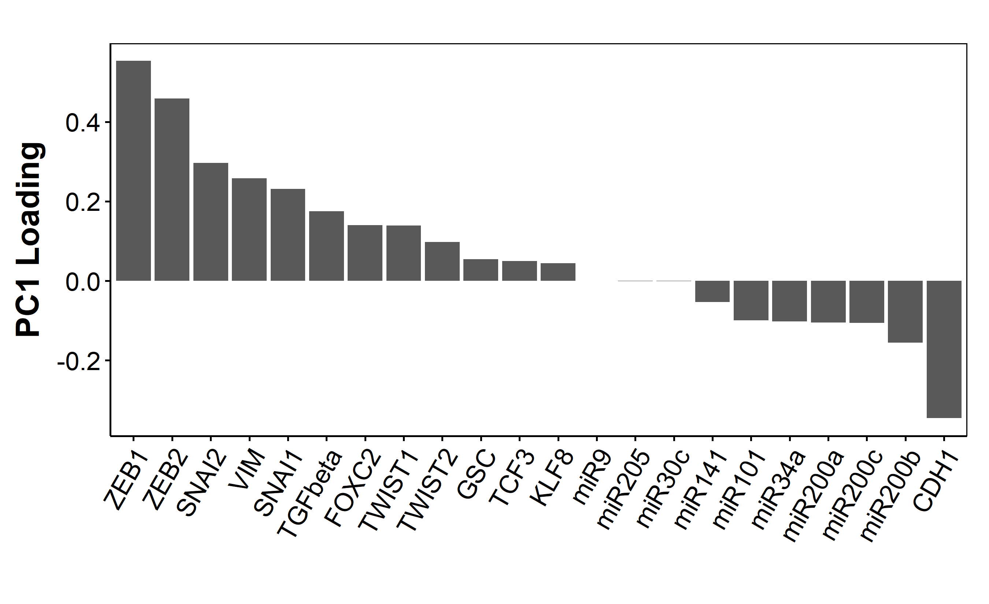
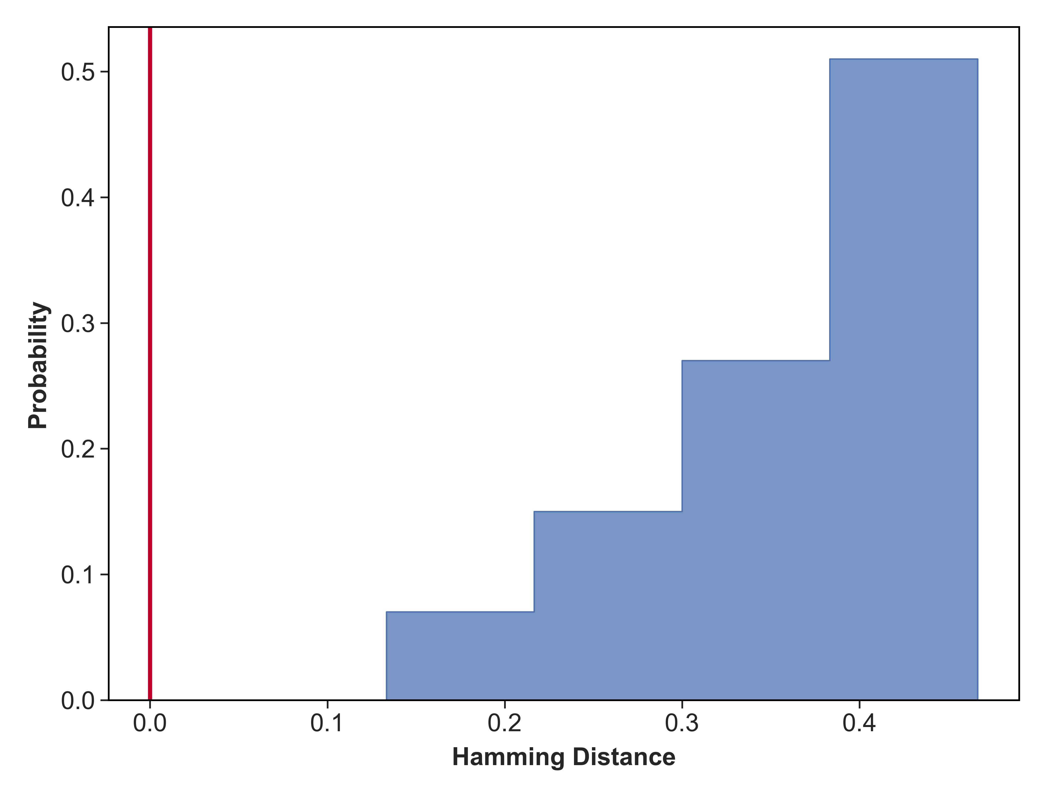
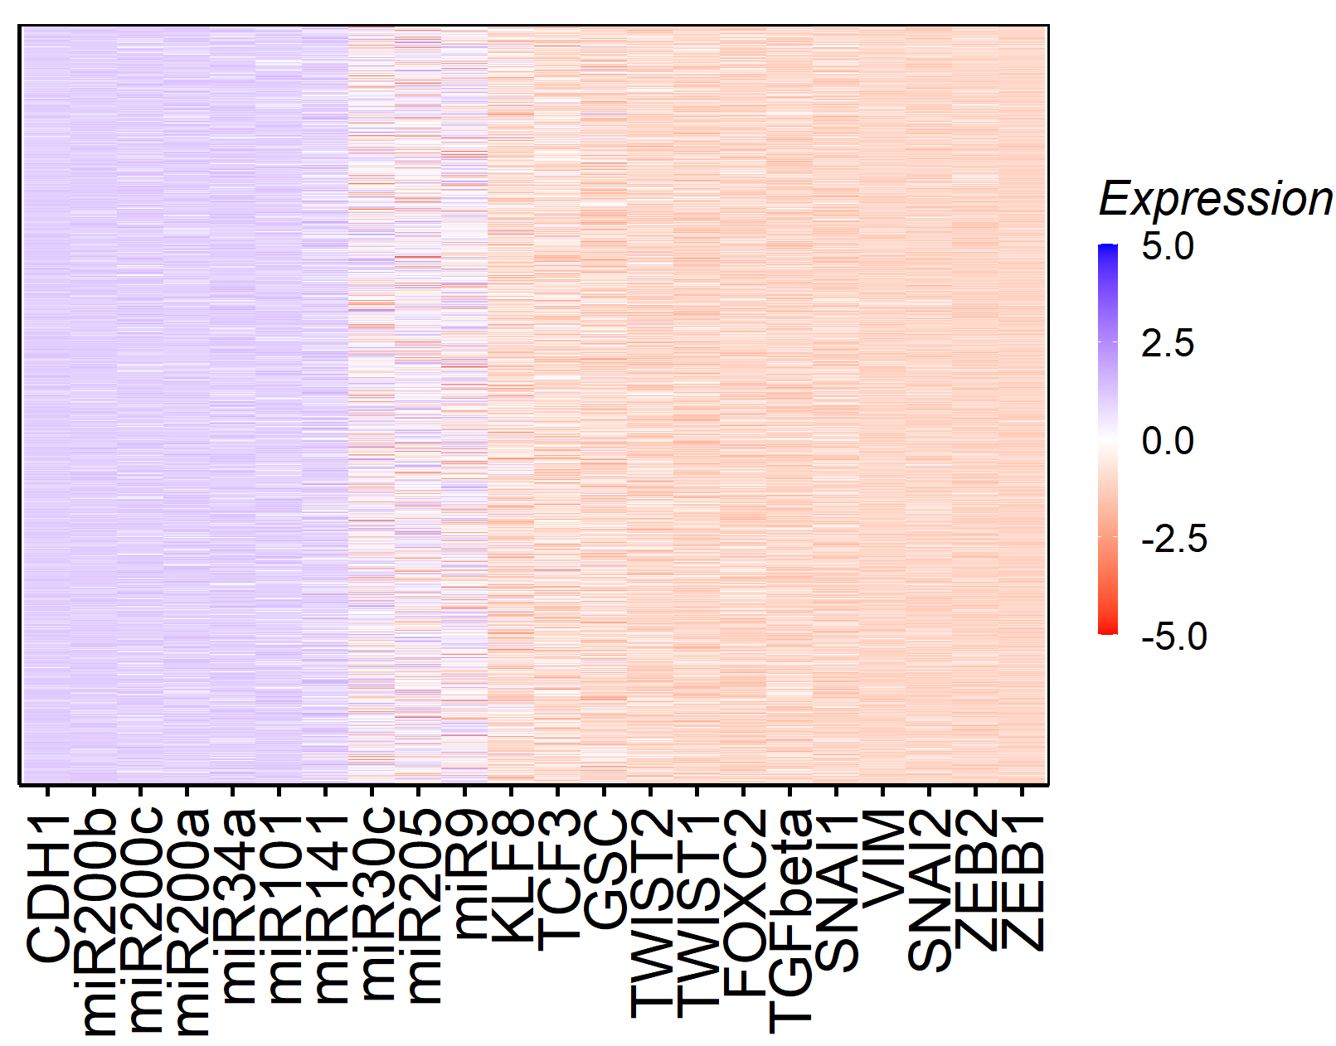
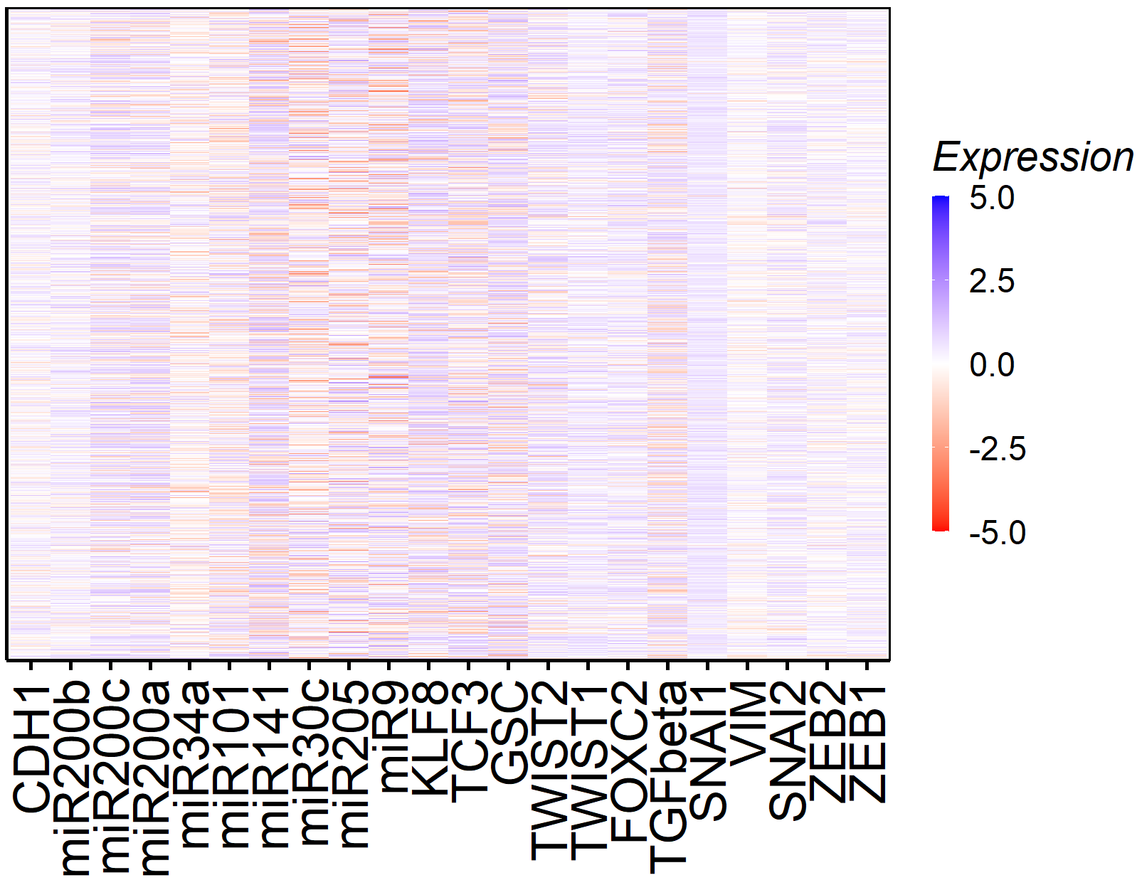
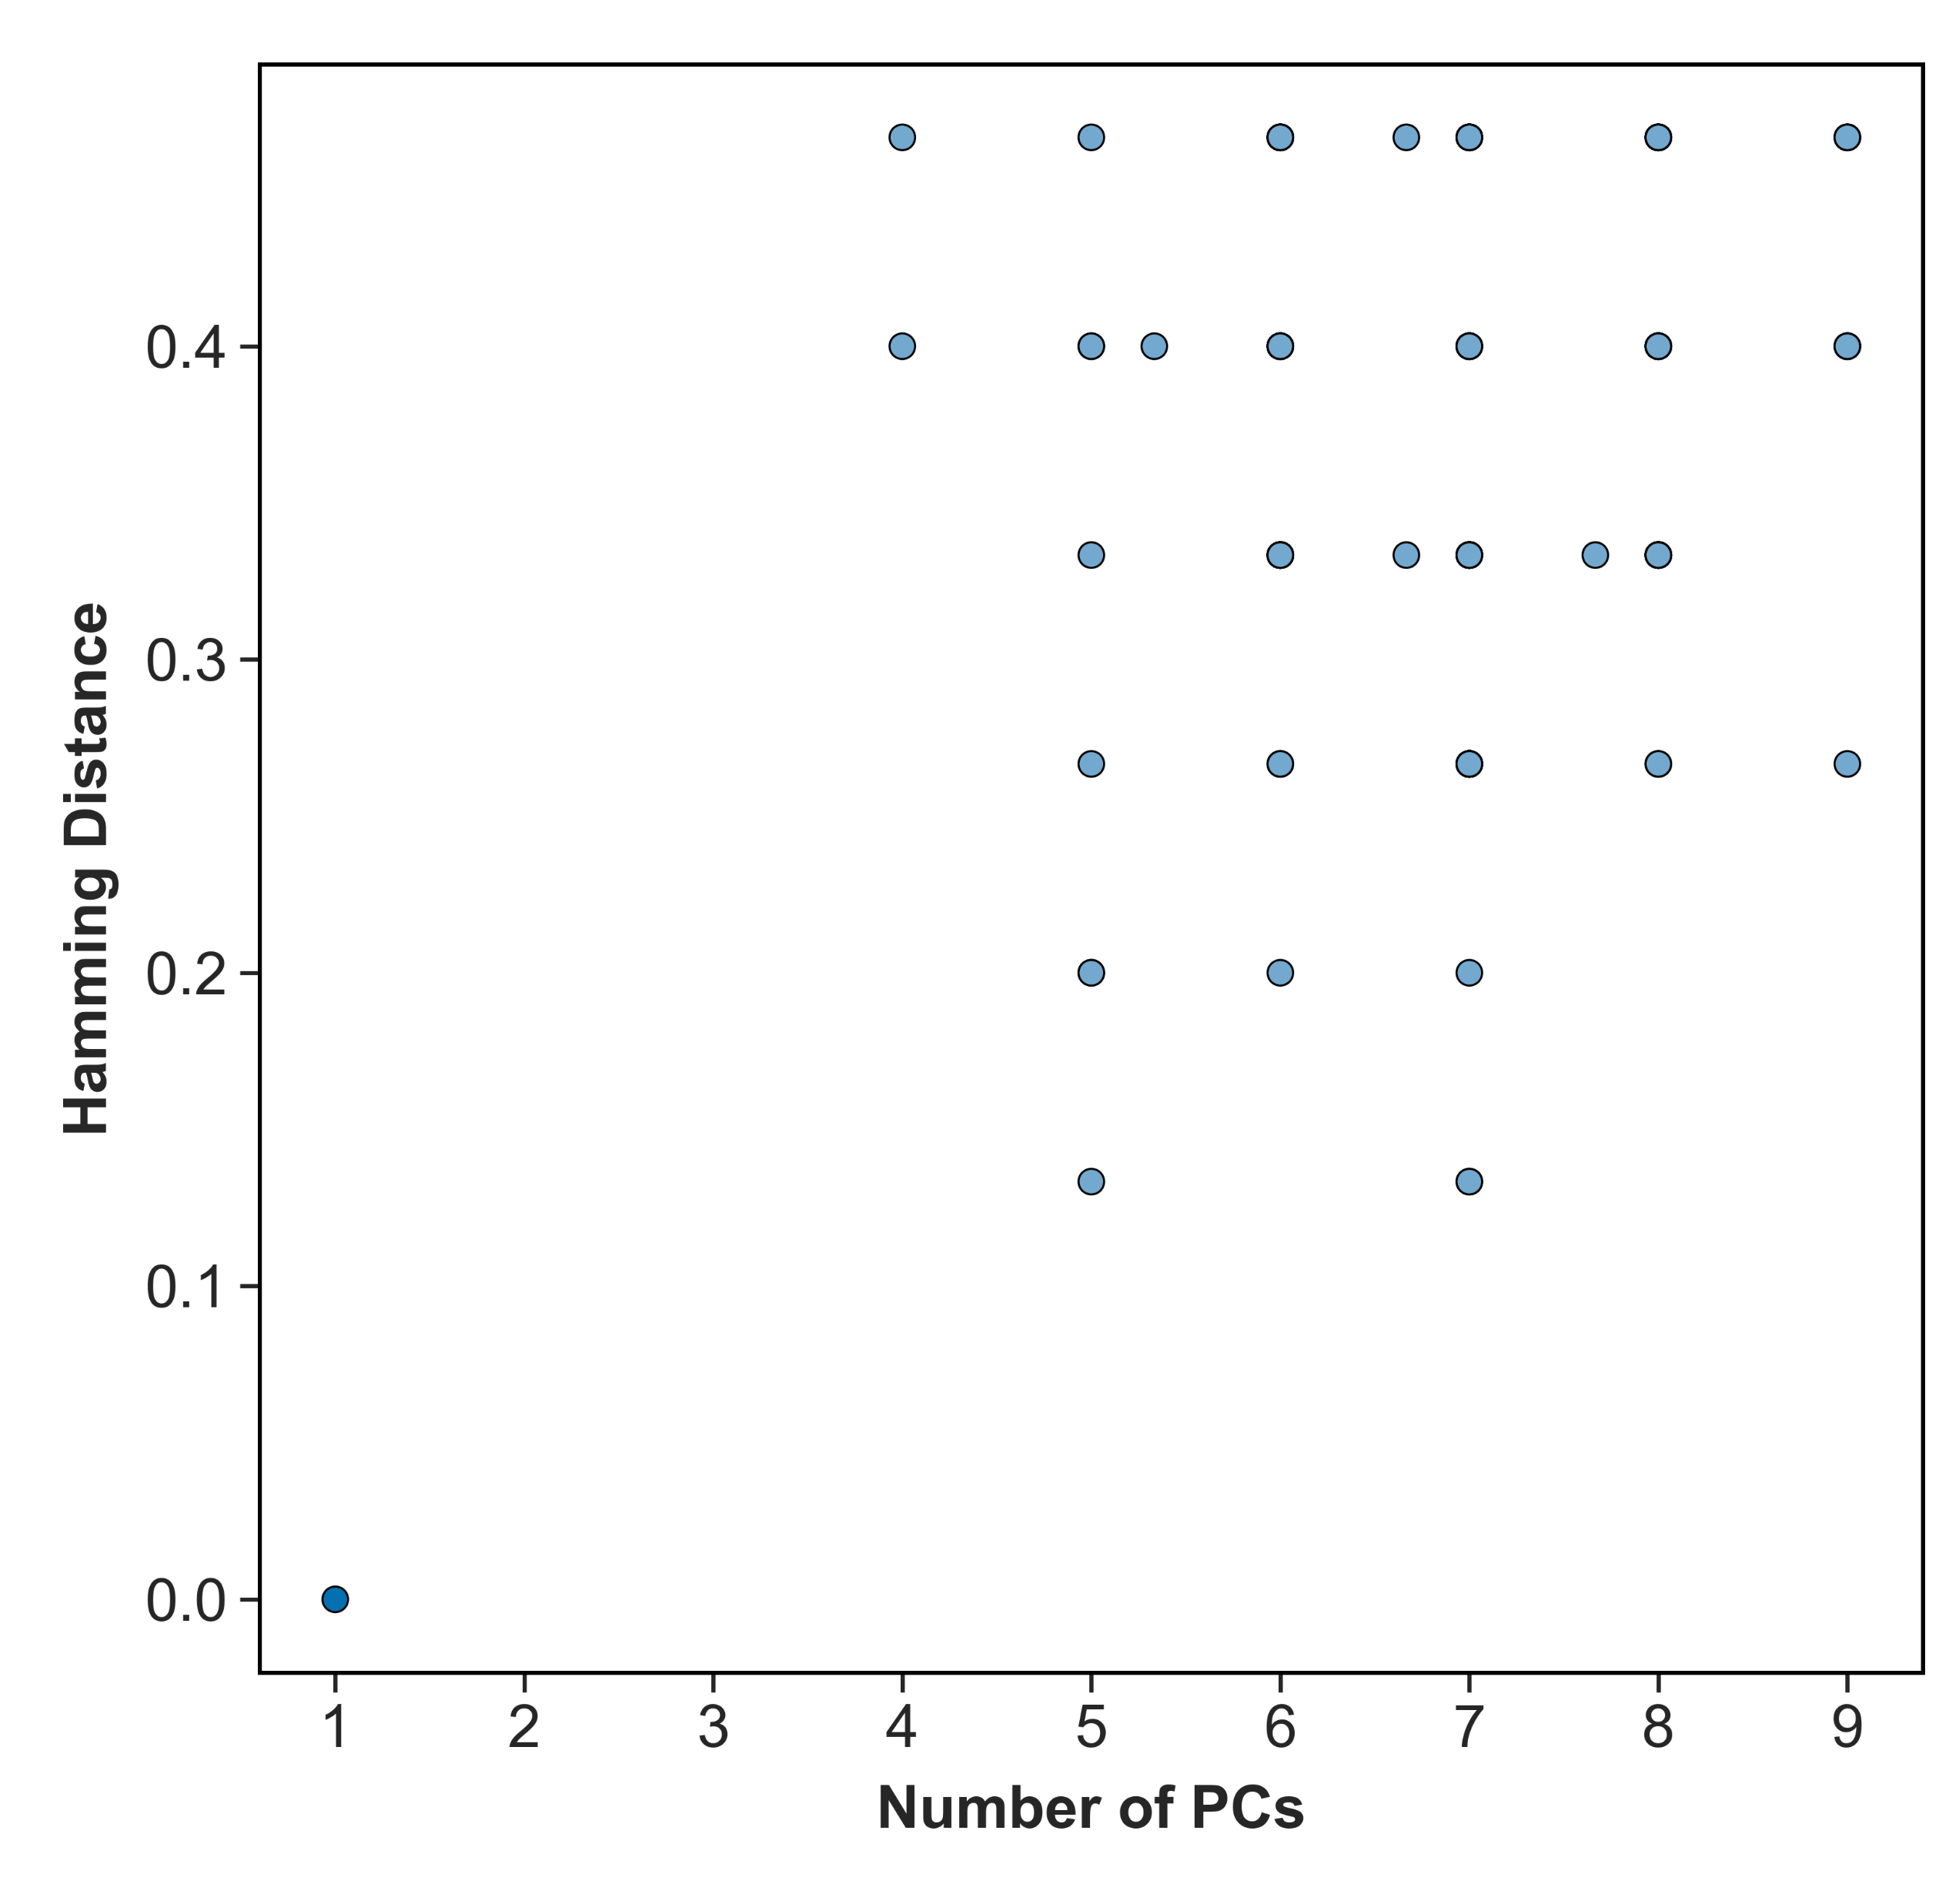
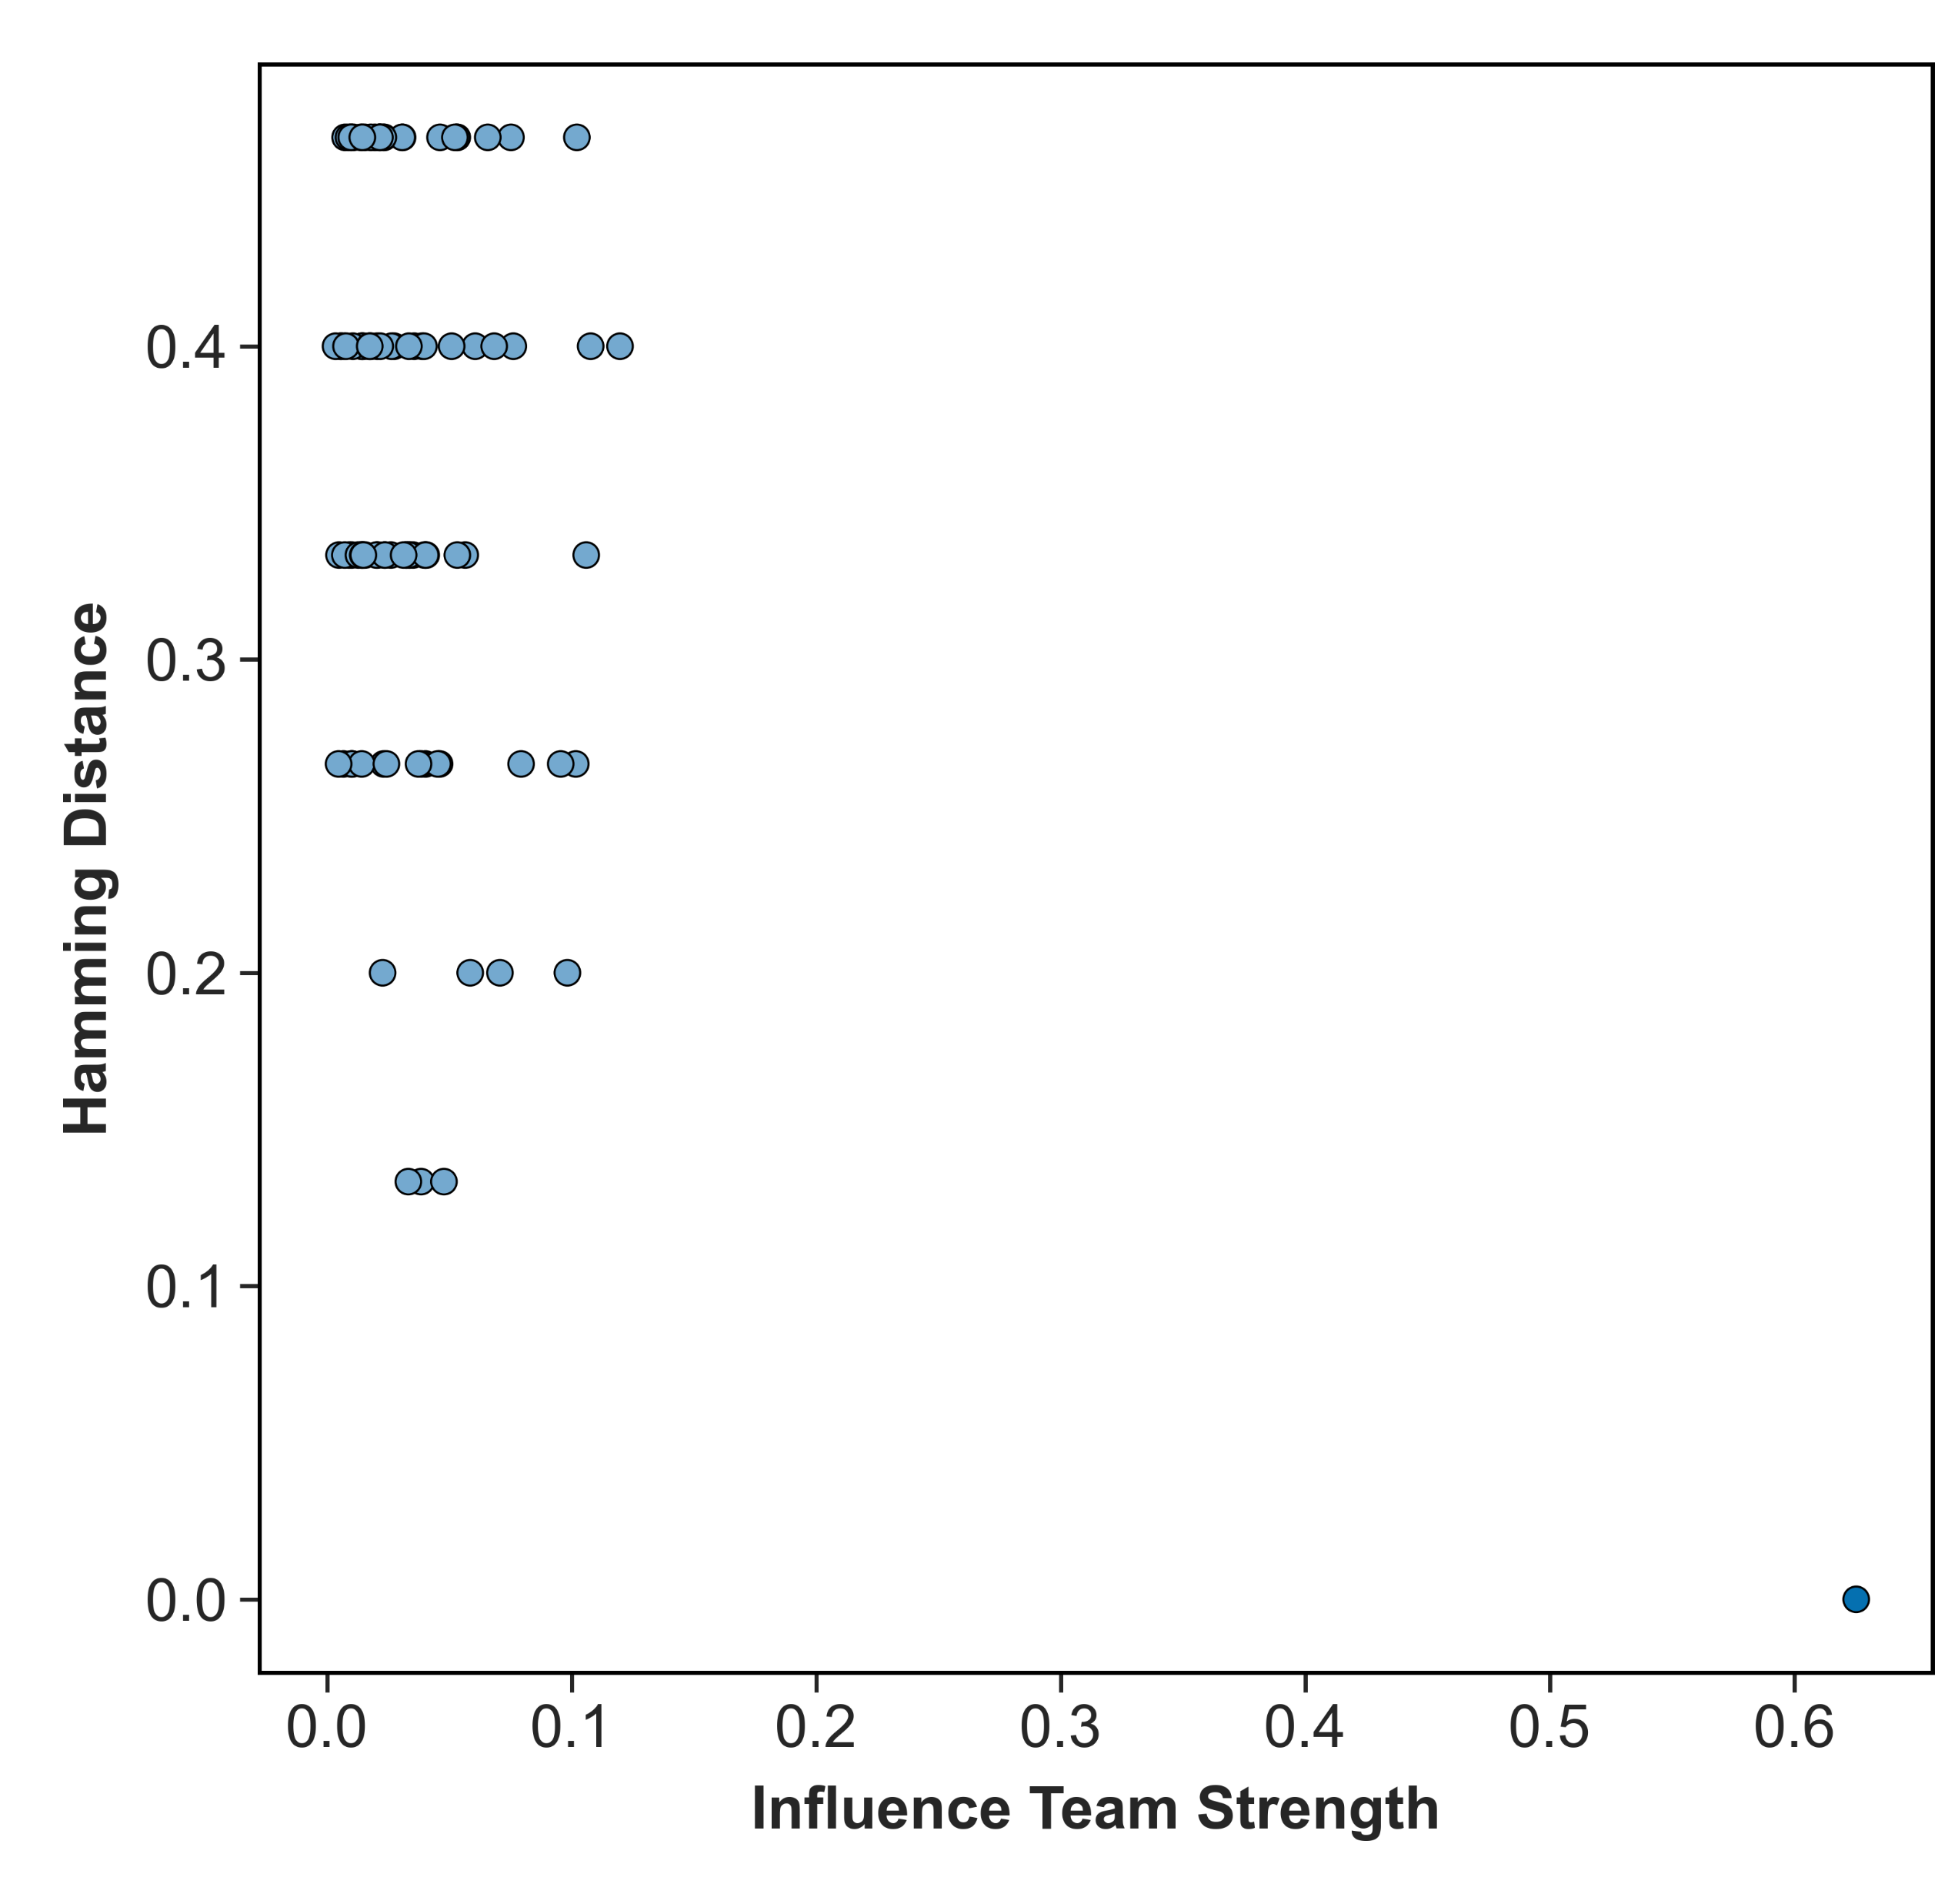

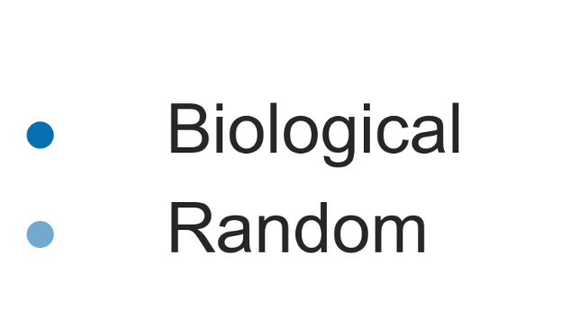
A (i)
A (ii)
B (i)
B (ii)
A (iii)
A (iv)
B (iii)
B (iv)
PCA identifies three phenotypes in RACIPE simulations
Scatterplot between PC1 and PC2 of the solution space. Each point represents one steady state
Heatmap for the cluster of points to the left in (i), corresponding to the mesenchymal phenotype. The z-normalised steady state levels of each node represented by the color-bar.
Heatmap for the cluster of points to the right in (i), corresponding to the Epithelial phenotype
Heatmap for the cluster of points at the top center in (i), corresponding to the hybrid phenotype(s).
Comparison of teams identified by Principle component analysis and influence matrix
Depiction of hamming distance as a measure to calculate the difference between the team compositions

